Slide 1

Some Basic Concepts of
Chemistry
Some Basic Concepts
of
Chemistry

Slide 2
Some Basic Concepts of
Chemistry
Syllabus
Matter – Classifications
International system of units
Measurable quanties of matter
Significant figures.
Laws of chemical combinations

Slide 3
Some Basic Concepts of
Chemistry
Atomic theory and atomic mass
Molecular mass, formula mass
Mole concept
Percentage composition
Molecular and Empirical formulae
Stoichiometry
Limiting reagent
Solutions – concentration termsn terms

Slide 4
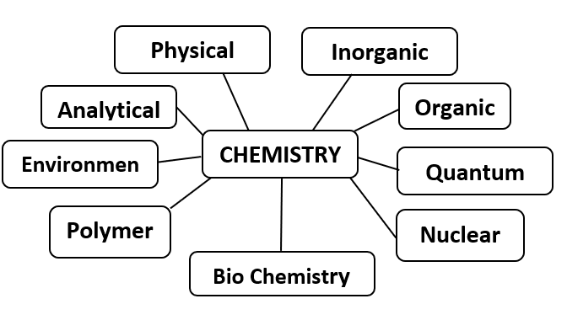
Some Basic Concepts of
Chemistry
Some Basic Concepts of Chemistry
Chemistry is the study of matter and it deals with the properties, composition, structure and the transformation they undergo, and the energy that is released or absorbed during these processes.
chemistry
Environmental

Slide 5
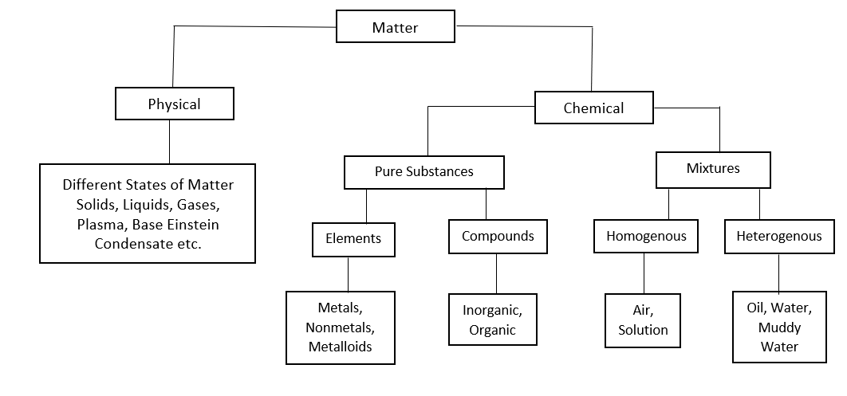
Some Basic Concepts of
Chemistry
Sochemistry
Eg.
Eg.
Air, solutions etc.
Oil and water, muddy water etc.

Slide 6
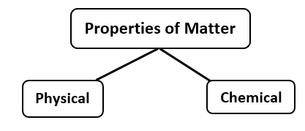
Some Basic Concepts of
Chemistry
Physical Properties: Can be measured or observed without changing the identify or the composition of the substance. Ex: - Colour, Odour, M.P, B.P, density etc.
Chemical Properties: Based on chemical changes during the characteristic reactions of different substances. Ex: - Acidity, basicity, combustibility etc.
The international system of units (SI). The SI System gas seven base units and these units pertain to the seven fundamental scientific quantities
chemistry
Physical Properties: Can be measured or observed without changing the identify or the composition of the substance. Ex: - Colour, Odour, M.P, B.P, density etc.
Chemical Properties: Based on chemical changes during the characteristic reactions of different substances. Ex: - Acidity, basicity, combustibility etc.
The international system of units (SI). The SI System gas seven base units and these units pertain to the seven fundamental scientific quantities.
Other quantities are derived from these quantities

Slide 7
Some Basic Concepts of
Chemistry
Base Physical Quantity | Symbol | Name & symbol
Length | l | Metre – m
Mass | m | Kilogram – kg
Time | t | Second – S
Electric Current | I | Ampere – A
Temperature | T | Kelvin – K
Amount of Substance | n | Mole – mol
Luminous Intensity | Iv | Candela - cd
chemistry

Slide 8
Some Basic Concepts of
Chemistry
Prefixes used in the SI System
Prefix Symbol Multiple
yocto y 10⁻²⁴
zepto z 10⁻²¹
atto a 10⁻¹⁸
Femto t 10⁻¹⁵
pico p 10⁻¹²
nano n 10⁻⁹
chemistry
1. One fermi is
1. 10⁻¹³ cm 2. 10⁻¹⁵ cm 3. 10⁻¹⁰ cm 4. 10⁻¹² cm

Slide 9

Some Basic Concepts of
Chemistry
micro 10⁻⁶
milli m 10⁻³
centi c 10⁻²
deci d 10⁻¹
deca da 10
hecto h 10²
kilo K 10³
mega M 10⁶
giga G 10⁹
tera T 10¹²
peta P 10¹⁵
exa E 10¹⁸
Zeta Z 10²¹
Yotta Y 10²⁴
chemistry

Slide 10
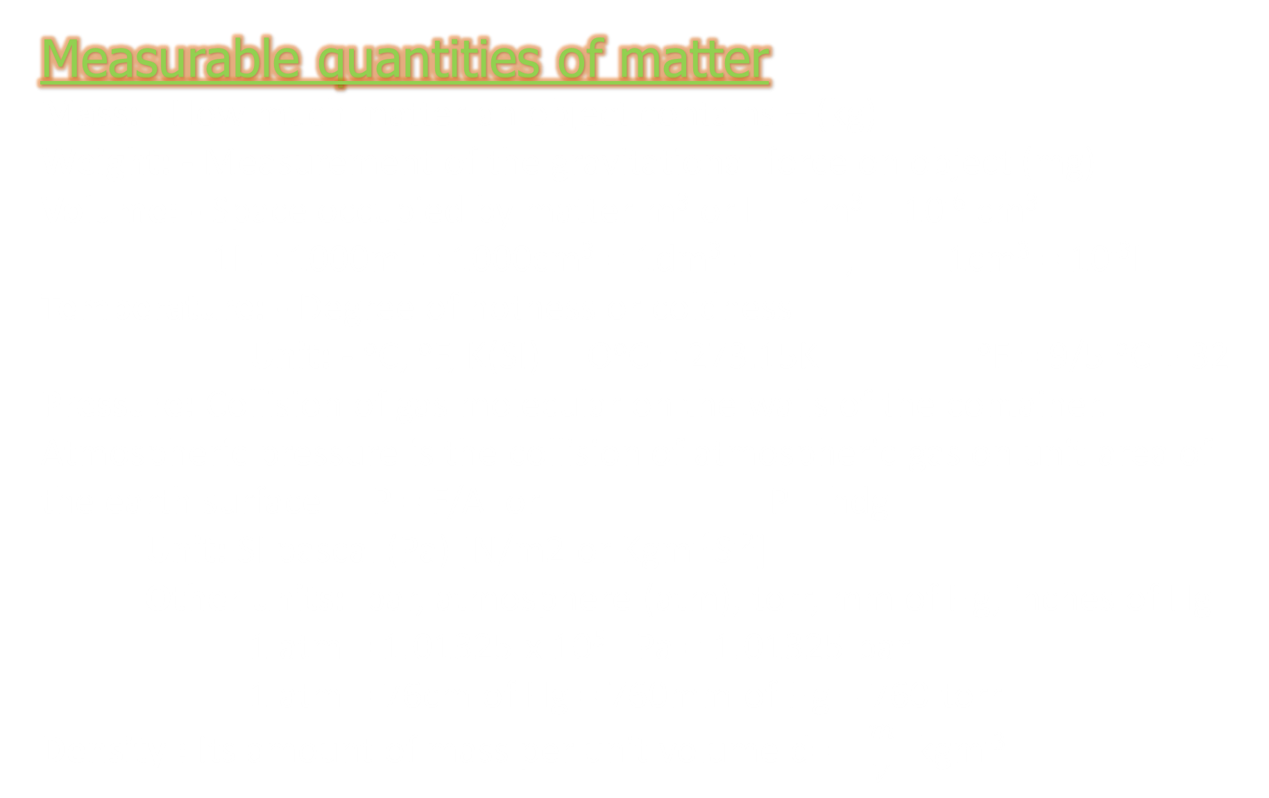
Some Basic Concepts of
Chemistry
Measurable quantities of matter
Mass: - How much matter an object contains – (kg)
Weight: - Measurement of the gravitational force on object (mg)
Volume: - Space occupied by matter m³ or L 1m³ = 10⁻⁶ cm³
1L = 1000ml = 1000cm³ = 1dm³ = , 1cm³ = 10⁻³L
Temperature: - Degree of hotness or coldness
Unit: - ºC, ºF, K(SI) OºC = 273.15K ºF = 9/5 ºC + 32
Pressure: Collision of gas molecular on the walls of the container. Atmospheric pressure is the collision of atmospheric gas on unit area of the earth surface P = F/A or P = hdg
Unit: SI pascal (Pa) [N/m2 or Kgm⁻¹S⁻²]
Other units: bar, atmosphere (atm), torr, mm of Hg, inches of Hg
1 atm = 1.01325 x 10⁵ Pa = 1.01325 bar
1 atm = 76cm of Hg = 760mm of Hg = 760 torr
Density : Its amount of mass per unit volume d= $\frac{m}{V}$ kgm⁻³
chemistry

Slide 11
Some Basic Concepts of
Chemistry
Uncertainly in measurement: Study of chemistry deals with experimental data as well as theoretical calculations.
There are meaningful way to handle the numbers. Conveniently and present data realistically with certainty to the extent possible. For that we are following
1. Scientific Notation: It is applicable for Avogadro’s No.
(6.022 x 10²³), Planck’s constant (6.626 x 10⁻³⁴JS) mass of
(9.1 x 10⁻³¹kg) etc.
2. Significant figures: During measurements, we are considering precision
and accuracy. Precision refers to the closeness of various
measurements for the same quantity. Accuracy is the agreement of
a particular value to the true value of the result. For example, if the
true value for the result of focal length of a convex Lense is 11 cm.
3 group of students reported as
chemistry

Slide 12
Some Basic Concepts of
Chemistry
Group I | Group II | Group III
10.5 | 10.4 | 10.9
11.0 | 10.5 | 11.0
10.2 | 10.3 | 11.1
10.6 | 10.4 | 11.0
Avg; - 10.57 | Avg: - 10.4 | Avg: - 11.0
Group I
Group II
Group III
10.5
10.4
10.9
11.0
10.5
11.0
10.2
10.3
11.1
10.6
10.4
11.0
Avg; - 10.57
Avg: - 10.4
Avg: - 11.0
chemistry
Group I – Values are not precise and accurate
Group II – Values are precise but not accurate
Group III – Values are both precise & accurate

Slide 13
Some Basic Concepts of
Chemistry
Significant figures: - Are meaningful digits which are known with certainty. The uncertainty is indicated by writing the certain digits and the last uncertain digit. Rules for finding the number of significant figures.
All non-zero digits are significant
For example: - (i) 473 cm, 3 significant figures (ii) 0.72ml, 2 significant figures
2. Zero preceding to first non-zero digit are not significant. Such zero
induces the position of decimal point.
Ex: 0.03 has one significant figure
0.0052 has two significant figures
chemistry

Slide 14
Some Basic Concepts of
Chemistry
Zero between two non-zero digits are significant
Ex: 2.005 has
four significant figures
4. Zero at the end or right of a number are significant provided they are
on the right side of the decimal point otherwise not significant
Ex: (i) 0.200g has 3 significant figures
(ii) 100 has only one significant figure
(iii) 100.00 has five significant figure
5. Exact numbers have infinite number of significant figures. EX: 2 balls,
10 eggs
When number are written is scientific notation, the number of digits
gives the number of significant figures
Ex: 4.01 x 10² has 3 significant figures
6.022 x 10²³ has 4 significant figures
chemistry

Slide 15
Some Basic Concepts of
Chemistry
Laws of chemical combination
Law of conservation of mass: Antoine Lavoisier
Matter can neither be created nor be destroyed. In a chemical reaction total mass of reactants should be equal to total mass of products. To obey this law, we follow only balanced chemical equations.
2SO₂ + O₂ 2SO₃
2 x (32 + 32) g 32g 2 x (32+48) = 2 x 80 = 160g
128g 32g
160g

Slide 16
Some Basic Concepts of
Chemistry
2. Law of definite or constant proportions – Joseph Proust:
The law states that a given compound always contains same elements combined in same fixed proportion by mass. For example, CO₂ can be prepared by using various methods but in all the cases CO₂ obtained contain only one C and two oxygen atoms combined in the ratio of 12: 32 is 3 : 8
3. Law of multiple proportion – John Dalton
Two elements combined to form more than one compound, the different mass of one of the element that combined with a fixed mass of the other element is in the ratio of simple whole numbers.
CO C – fixed difference in mass ratio of oxygen is
C + O₂ 16 : 32 is 1: 2
CO₂
2. The pairs that illustrate law of multiple proportion are
1. Cu₂O & CuO 2. PbO & PbO₂ 3. SnCl₂ & SnCl₄ etc.

Slide 17
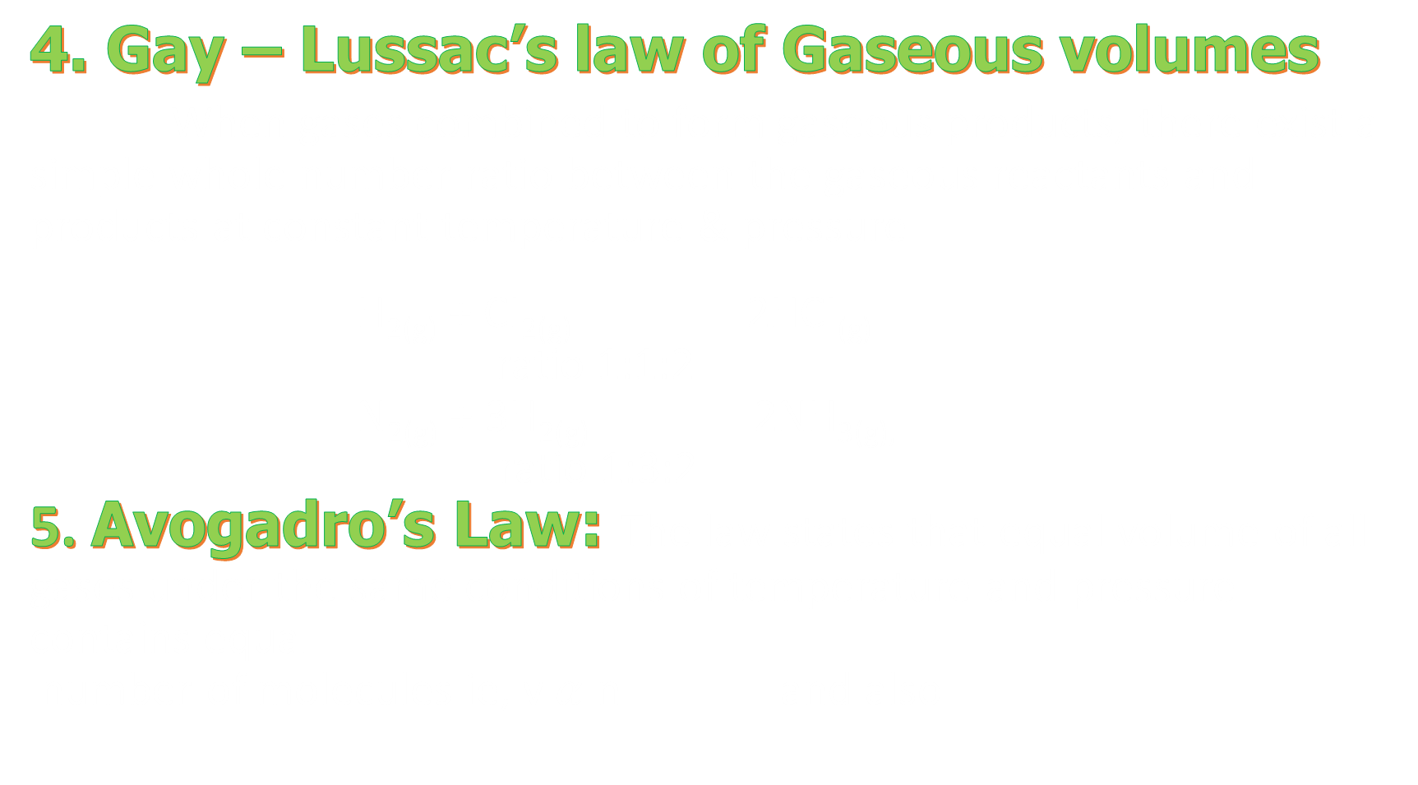
Some Basic Concepts of
Chemistry
4. Gay – Lussac’s law of Gaseous volumes
When gases combined to form gaseous products, there exist a simple whole number ratio between the gaseous reactants and products at constant temperature & pressure
H_{2(g)} + CI_{2(g)} 2HCI_{(g)}
ratio 1:1:2
N_{2(g)} + 3H_{2(g)} 2NH_{3(g),}
ratio 1:3:2
5. Avogadro’s Law: The law states that equal volume of all gases under the same conditions of temperature and pressure contains equal
number of molecules ie, v $α$ n and also

Slide 18
Some Basic Concepts of
Chemistry
3. Which of the following pairs of substance illustrate the law of
multiple proportions
1. CO and CO₂ 2. H₂ O and D₂ O
3. NaCl and NaBr 4. MgO and Mg(OH)₂
4. Chemical equation is balanced according to the law of
1. Multiple proportion 2. Reciprocal proportion
3. Conservation of mass 4. Definite proportions

Slide 19
Some Basic Concepts of
Chemistry
5. The law of multiple proportions is illustrated by the
two compounds
1. Sodium chloride and sodium bromide
2. Ordinary water and heavy water
3. Caustic soda and caustic potash
4. Sulphur dioxide and sulphur trioxide
6. Number of molecules in 100 ml of each of O_{2,} NH₃ and CO₂ at
STP are
1. In the order CO₂< O₂ < NH₃ 2. In the order NH₃ < O₂ < CO₂
3. The same 4. NH₃ = CO₂< O₂

Slide 20
Some Basic Concepts of
Chemistry
Dalton’s Atomic Theory
All matter is made up of minute indivisible particles called atoms.
Atoms of same elements having same properties like mass, size etc.
Atoms of different elements having different properties like size, mass etc.
Atoms can neither be created nor be destroyed.
Atoms are the smallest particles that can take part in chemical reactions.
Atoms of the same elements combine together to form simple molecules (H₂, O₂, N₂ etc) and atoms of different elements combined together to form compound molecules. (H₂O, NH₃, NO₂, H₂SO₄ etc)
chemistry

Slide 21
Some Basic Concepts of
Chemistry
Demerits:
According to Dalton’s theory
I. Atoms are indivisible but now a days atoms consists of sub
atomic particles like protons, electrons and neutrons - atoms
are divisible.
II. Atoms of same elements having same properties but after
the discovery of isotopes atoms of same element having
different property.
III. Atoms of different element having different properties but after
the discovery of isobars atoms of different elements having
same property

Slide 22
Some Basic Concepts of
Chemistry
Atomic mass - Relative atomic mass:
It is the mass of an atom that related to 1/12 the mass of a C-12 atom. It is expressed in atomic mass unit (amu)
1 amu =
In terms of amu, the mass of hydrogen atom (mass of an atom of hydrogen
= 1.6736 x 10⁻²⁴ g)
Now a days amu has been replaced by ‘u’ – unified mass.
5. I amu is equal to
1. 2.
3. 1 g of H₂ 4. 1.66 x 10 ⁻²³ kg

Slide 23
Some Basic Concepts of
Chemistry
Average atomic mass: Many naturally occurring elements exist in number of isotopes. Average atomic mass depending on the relative natural abundance of its isotopes. For example,
Carbon has 3 isotopes with relative abundances as,
C-12 98.892%, C-13 1.108% and C-14 2x10^{-10 %}
The average atomic mass of carbon
2. The % abundance of 3 isotopes of Fe are
The average atomic mass of iron = 54 x .05 + 56 x 0.90 + 57 x .05
= 55.95 u

Slide 24
Some Basic Concepts of
Chemistry
Molecular mass:
Sum of atomic masses of the elements present in a molecule. In the case of monoatomic molecule, its atomic mass becomes equal to molecular mass.
MOLECULE | MOLECULAR MASS (u) | MOLECULE | MOLECULAR MASS (u)
C | 12 | H₂O | 18
Na | 23 | CO₂ | 44
Ca | 40 | CH₄ | 16
N₂ | 28 | H₂SO₄ | 98
O₂ | 32 | NaOH | 40
Cl₂ | 71 | C₆H₁₂ O₆ | 180

Slide 25
Some Basic Concepts of
Chemistry
Formula mass:
It is defined as the sum of the atomic masses of Constituent atoms in the compound. This is generally used for ionic compounds. It may be noted that is NaCl, one Na⁺ surrounded by six Cl⁻ and vice – versa. The formula such as NaCl is used to calculate the formula mass.

Slide 26
Some Basic Concepts of
Chemistry
Mole Concept:
It is a counting unit to count atoms, molecule, ions, protons, electrons etc. It is the exact number that must be present in 12g of a C - 12 atom. One mole of any substance contains 6.022 x 10²³ particles. This number is introduced by Amedio Avogadro, hence it is called Avogadro’s constant (N_{A}).
I. Any element its gram atomic mass contains Avogadro number
of atoms.
II. Any molecule its gram molecular mass contains Avogadro number
of molecules.

Slide 27
Some Basic Concepts of
Chemistry
calculation of number of atoms and molecules
Number of atoms in 120 g of magnesium
Atomic mass of Mg = 24 u
Number of atoms in 120g of Mg
Number of molecules in 8.8g of CO₂
Molecular mass of CO₂ = 44 g/mol
Number of molecules in 8.8g CO₂
chemistry

Slide 28
Some Basic Concepts of
Chemistry
Molar Volume: Volume occupied by one mole of any gas at
STP is 22.4L and it is called molar volume.
Ex. 120L of NH ₃ is collected at STP, the number
of moles of NH₃ obtained is
At STP, 1 mole = 22.4L.
Number of moles in 120L

Slide 29
Some Basic Concepts of
Chemistry
7. I mol of CH₄ contains
1. 6.02 x 10²³ atoms of H 2. 4 g atom of Hydrogen
3.1.81 x 10²³ Molecules of CH₄ 4. 3.0 g of carbon
8. The number of atoms in 4.25 g of NH₃ is approximately
1. 1 x 10 ²³ 2. 2 x 10 ²³
3. 4 x 10²³ 4. 6 x 10²³
9. If N_{A} is Avogadro’s number then number of valence
electrons in 4.2 g of nitride ions (N³⁻)
1. 2.4 N_{A} 2. 4.2 N _{A} 3. 1.6 N_{A} 4. 3.2 N_{A}

Slide 30
Some Basic Concepts of
Chemistry
10. which has maximum number of atoms of oxygen
1. 10 ml H₂ O(l) 2. 0.1 mole of V₂ O₅
3. 12 gm O₃ (g) 4. 12.044x10²² molecules of CO₂
11. Mass of one atom of the element A is 3.9854 x 10⁻²³
How many atoms are contained in 1 g of the element A?
1.2.509 x 10²² 2. 6.022 x 10²³
3. 12.044 x 10²³ 4. None

Slide 31
Some Basic Concepts of
Chemistry
12. How many moles of magnesium phosphate Mg₃(PO₄)₂
will contain 0.25 mole of oxygen atoms:
1. 0.02 2. 3.125 X 10⁻²
3. 1.25 X 10⁻² 4. 2.5 X 10⁻²
13. The total number of protons in 10 g of calcium carbonate
is (N₀ = 6.023 x 10²³)
1.1.5057 x 10 ²⁴ 2. 1.0478 x 10 ²⁴
3. 3.0115 x 10 ²⁴ 4. 4.0956 x 10 ²⁴chemistry
14. 7.5 grams of a gas occupy 5.8 litres of volume at STP
the gas is
1. NO 2. N₂ O 3. CO 4. CO₂ chemistry

Slide 32
Some Basic Concepts of
Chemistry
15. One litre of a gas at STP weight 1.16 g it can possible be
1. C₂H₂ 2. CO 3. O₂ 4. CH₄
16. The mass of a molecule of water is
1.3 x 10⁻²⁶ kg 2. 3 x 10⁻²⁵ kg
3. 1.5 x 10⁻²⁶ kg 4. 2.5 x 10⁻²⁶ kg
17. The number of molecule at NTP in 1 ml of an ideal gas
will be
1. 6 x 10²³ 2. 2.69 x 10¹⁹
3. 2.69 x 10²³ 4. None of these

Slide 33
Some Basic Concepts of
Chemistry
18. Volume of a gas at STP is 1.12 x 10⁻⁷ cc. Calculate
the number of molecules in it
1. 3.01 x 10²⁰ 2. 3.01 x 10¹²
3. 3.01 x 10²³ 4. 3.01 x 10²⁴ chemistry
19. 4.4 g of an unknown gas occupies 2.24 L of volume at
standard temperature and pressure. The gas may be
1. carbon dioxide 2. Carbon monoxide
3. Oxygen 4. Sulphur dioxide
20. The number of oxygen atoms in 4.4 g of CO₂ is approx.
1. 1.2 x 10²³ 2. 6 x 10²²
3. 6 x 10²³ 4. 12 x 10²³

Slide 34
Some Basic Concepts of
Chemistry
Gram atom: Atomic mass expressed in gram is called gram atom.
1g atom of any element contains Avogadro number
of atoms.
1g atom of C = 12g C = 6.022 x 10²³ atom
1g atom of Mg = 24 g = 6.022 x 10²³ atoms
2.5g atom of Ca = 2.5 x 40g = 100g = 2.5 N_{A} atoms
21. The number of atoms present in 0.5 g-atoms of nitrogen is same as the atoms in
1. 12 g of C 2. 32 g of S
3. 8 g of oxygen 4. 24 g of Mg

Slide 35
Some Basic Concepts of
Chemistry
Gram mole : Molecular mass expressed in gram is called
gram mole. One gram mole of any molecule contains Avogadro number of molecules.
1g mole of H₂ = 2g = 6.022 x 10²³ molecule
1g mole of Cl₂ = 71g = N_{A} molecules
1g mole of Na = 23g = N_{A} molecules
1g mole of NH₃ = 17g = N_{A} molecules
chemistry

Slide 36
Some Basic Concepts of
Chemistry
Percentage Composition
Mass % of an element =
% Composition of H₂O.
% Composition of H₂ =
% Composition of O₂ ₌
% Composition of oxygen in glucose
% composition of oxygen.
23. The percentage of oxygen in NaOH is
1. 40 2. 60 3. 8 4. 10

Slide 37
Some Basic Concepts of
Chemistry
24. Caffeine has a molecular weight of 194. If it
contains 28.9% by mass of nitrogen, number of
atoms of nitrogen in one molecule of caffeine is
1. 4 2. 6 3. 2 4. 3
25. What is the % of H₂O in Fe(CNS)₃. 3H₂O
1. 45 2. 30 3. 19 4. 25
26. A hydrocarbon contains 86% carbon, 488ml of
the hydrocarbon weight 1.68 g at STP. Then the
hydrocarbon is an
1. Alkane 2. Alkene
3. Alkyne 4. Arene

Slide 38
Some Basic Concepts of
Chemistry
Empirical formula and molecular formula
Empirical formula is the simplest whole number ratio of various atoms present in a compound. Molecular formula is the actual ratio of all the elements present in a compound.
Molecule | M.F | E.F
Glucose | C₆H₁₂O₆ | CH₂O
Benzene | C₆H₆ | CH
Carbonic acid | H₂CO₃ | H₂CO₃
Relation between M.F & E.F
M. F = n x E.F, n=1,2,3…..
Calculation of n
n =
Eg: Glucose, E.F is CH₂O

Slide 39
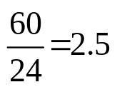
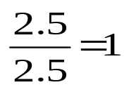
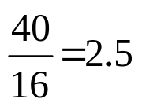
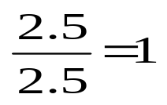
Some Basic Concepts of
Chemistry
Determination of E.F from % composition
1. Mole ratio = (Number of moles) =
2. Simple ratio – Divide each mole ratio with the least mole ratio
3. Convert simple ratio into nearest whole number
Ex: 60% of a metal M (atomic mass 24) combines with oxygen to form an oxide. The E.F of the oxide is
The E.F of the oxide is MO
Elements | Number of Moles | Simple Ratio
M
O

Slide 40
Some Basic Concepts of
Chemistry
Solved Ex: i. An organic substance containing carbon, hydrogen and oxygen gave the following percentage composition.
C = 40.784%; H=5.085% and O=54.228%
The molecular weight of the compound is 118. Calculate the molecular formula of the compound.
Element | Mole ratio | Simple ratio | Nearest whole No.
C |  |  | 2
H |  |  | 3
O |  |  | 2

Slide 41
Some Basic Concepts of
Chemistry
Empirical Formula is C₂ H₃ O₂
Molecular formula = C₄ H₆ O₄
ii. A gas is found to have the formula (CO)_{x}. its vapour density is 70. The value of x must be
Sol:- (CO)_{x} = 140 (molar mass = 2 x V.D)
E.F mass = 28
x = = 5

Slide 42

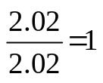

Some Basic Concepts of
Chemistry
Elements | Mole Ratio | Simple Ratio | Simplest Whole Number
C |  | 1 | 1
H |  | 2 | 2
Cl |  | 1 | 1
Solved Example
1. A Compound contains 4.07% hydrogen, 24.27% carbon and
71.65% chlorine. Its molar mass is 98.96g. What are its empirical and molecular formulas?
E.F is CH₂Cl
M.F = n x E.F M.F = 2 x CH₂Cl = C₂ H₄ Cl₂
2.Acetylene and benzene both have the empirical formula CH.
The molecular masses of acetylene and benzene are 26 and 78 respectively. Deduce their molecular formula.
E.F = CH M.F of acetylene = n x E.F = 2 x CH = C₂ H₂ Benzene,
M.F of benzene = 6 x CH = C₆ H₆

Slide 43
Some Basic Concepts of
Chemistry
Stoichiometry: It is the calculations of the quantities of reactants and products involved in a chemical reaction. The co-efficient that correlating number of moles, volumes and masses of various reactants and products in a chemical reaction is called Stoichiometric co-efficient. Ex: 2H₂ + O₂ ---------→ 2 H₂O
According to Stoichiometry
i. 2 moles of H₂ combines with one mole of O₂ to form
2 moles of H₂O
ii. 2 volumes of H₂ combines with 1 volume of O₂ to form
2 volumes of H₂O
iii. 4g of H₂ combines with 32g of O₂ to form 36g (2 x 18)
of H₂O
chemistry

Slide 44
Some Basic Concepts of
Chemistry
Solved Example
i) In Haber’s Process, the amount of NH₃ produced by the reaction of 10g
of H₂ is N₂ + 3H₂ --------→ 2NH₃
6 g 2 x 17g
10g xg

Slide 45
Some Basic Concepts of
Chemistry
ii) Amount of limestone required to produce 100g CO₂ is
CaCO₃ --------→ CaO + CO₂
100g 44g
xg 100g
iii) Amount of oxygen required for the complete combustion of
27g of Aluminium is
4Al + 3O₂ ---------→ 2Al₂ O₃
4 x 27 3 x 32
27 x
chemistry

Slide 46
Some Basic Concepts of
Chemistry
iv) The volume of CO₂ obtained at STP by the decomposition of 20g
of CaCO₃ is
CaCO_{3(s)} --------→ CaO_{(s)} + CO_{2(g)}
_{100 g 22.4L}
20 g x
v) Calculate the amount of water produced by the combustion of 16g
of methane
CH_{4(g)} + 2O_{2(g)} ----------→ CO_{2(g)} + 2H₂O_{(g)}
16 g 2 x 18 = 36g
_{Amount of water produced = 36g}

Slide 47
Some Basic Concepts of
Chemistry
27. If isobutane and n-butane are present in a gas, then how
much oxygen should be required for complete combustion of
5 kg of this gas
1. 17.9 kg 2. 9 kg
3. 27 kg 4. 1.8 kge
28. 12 g of Mg (at. Mass 24) will react completely with acid
to give
1. One mole of H₂ 2. ½ mole of H₂
3. 2/3 mole of O₂ 4. Both ½ mol of H₂ and ½ mol of O₂

Slide 48
Some Basic Concepts of
Chemistry
29. 100 g CaCO₃ reacts with 1 litre 1 NHCl. On completion of
reaction how much weight of CO₂ will be obtain
1. 5.5 g 2. 11 g 3. 22 g 4. 33 g y
30. Calculate volume of carbon dioxide produced on
heating 10 g of limestone at S.T.P.
1. 2.24 L 2. 22.4 L
3. .224 L 4. 2.24 ml chemistry

Slide 49
Some Basic Concepts of
Chemistry
31. Find the volume of CO required to reduce 0.25 mole
ferric oxide as per the given equation
1.16.8 dm³ 2. 67.2 dm³
3. 22.4 dm³ 4. 44.8 dm³
32. How many litre of oxygen at STP is required to burn 60 g C₂ H₆?
1. 24.4 L 2. 11.2 L 3. 22.4 x 7 L 4. 8.5 L

Slide 50
Some Basic Concepts of
Chemistry
Limiting Reagent: The reagent that completely consumed in a chemical reaction is called limiting reagent.
For example, 10 moles of H₂ and 10 moles of O₂ are reacted for the formation of water. Identify the limiting reagent.
According to the equation (2H₂ + O₂ ----→ 2H₂O) 10 moles of H₂ required 5 moles of O₂. Hence H₂ is the limiting reagent. Number of moles of water produced is 10 moles (10 x 18 = 180g).
Solved Example
i. 100g of H₂ and 200g of oxygen are reacted for the formation of water. Identify the limiting reagent and how much amount of water will be produce 2H₂ + O₂ ----------→ 2H₂O
100g 200g
Number of moles =

Slide 51
Some Basic Concepts of
Chemistry
6.25 moles of O₂ required 12.50 moles of H₂. Hence O₂ is the
limiting reagent.
6.25 moles of O₂ produce 12.50 moles of water.
Amount of water produced = 12.50 x 18 = 225g
ii. 50 kg of N₂ and 10kg of H₂ are mixed to produce NH₃ calculate the amount of NH₃ produced and identify the limiting reagent.
N₂ + 3H₂ --------→ 2NH₃
50000g 10000g
chemistry
According to the equation 1785.71 moles of N₂ required 5357.13 moles of H₂ . 5000 moles of H₂ required 1666.66 moles (5000/3) of N₂. Hence H₂ is the limiting reagent. 3 moles of H₂ produced 2 moles of NH₃ 5000 moles of H₂ produced

Slide 52
Some Basic Concepts of
Chemistry
iii. Two oxides of a metal contain 50% and 40% metal M respectively.
If the formula of the first oxide is MO₂ then the formula of the
Second oxide will be
First oxide, MO₂ mole ratio,
Second oxide, mole ratio

Slide 53
Some Basic Concepts of
Chemistry
iv. 10g of hydrogen and 64g of oxygen were filled in a steel vessel and
expolded. How many moles of water will be produced.
2H₂ + O₂ ---------→ 2H₂O
10g 64g
5 moles 2 moles
2 moles of O₂ required 4 moles of H₂
Number of moles of water produced is 4 moles.
v. The % of an element M is 53 in its oxide of molecular formula M₂O₃.
its atomic mass is

Slide 54
Some Basic Concepts of
Chemistry
33. A solution is prepared by adding 2g of a substance A
to 18 g of water. Calculate the mass percent of the solute.
1. 8% 2. 9% 3. 10% 4. 11%istry
34. What will be the molality of the solution made
by dissolving 10 g of NaOH in 100 g of water?
1.2.5 m 2. 5 m 3. 10 m 4. 1.25 m
35. A given solution of NaOH contains 4.00 g of NaOH per litre
of solution. Calculate the molarity of this solution.
( Molar mass of NaOH = 40.00 g)
1. 0.1 M 2. 0.5 3. 0.7 4. 0.8

Slide 55
Some Basic Concepts of
Chemistry
Solution
It is a homogenous mixture of two or more components.
The substance which dissolves is called solute and in which it is dissolving is called solvent. Solvent + solute --------→ Solution
The process of dissolving one substance in another is called dissolution. It is not a chemical change.
The maximum amount of solute that can be dissolved in a particular amount of solvent (100ml) is called its solubility.
If a solution contains only one solute, then it is called a binary solution.
The properties of solution mainly depend on solute particles. The amount of solute present in a solution is called its concentration. It can be expressed by using different terms. They are
chemistry

Slide 56
Some Basic Concepts of
Chemistry
1.Mass Percentage: Mass of solute in grams present in 100g of
the solution. It is the ratio of mass of solute to total mass
of solution
2. Volume Percentage:
3. Molarity (M): It is the number of moles of solute present per
litre of the solution. It depends on Temperature
Unit of molarity = Moles / L
Molarity of mixed solution: If two solutions are mixed,
Molarity & Volume of first solution = M₁V₁
Molarity & Volume of second solution = M₂ V₂
Molarity of the mixed solution,
chemistry

Slide 57
Some Basic Concepts of
Chemistry
Molarity concept when two solutions are reacted
1. NaOH_{(aq)} + HCl_{(aq)} -------→ NaCl_{(aq)} + H₂O
M₁V₁ M₂V₂
According to molarity concept, the ratio of molarity & volume of these two solutions are in the ratio of their number of moles in the balanced chemical equation
2. 2KOH + H₂SO₄ -----→ K₂SO₄ + 2H₂O
M₁V₁ M₂V₂
Volume of water added to change the molarity M₁ to M₂ (dilution)

Slide 58
Some Basic Concepts of
Chemistry
Molality (M): It is the number of moles of solute present per Kg of
the solvent.
Unit ----→ Moles / Kg. It is independent on temperature.
Normality (N): It is the number of gram equivalent of solute present per litre of the solution.
Unit ----→ g Equivalent / L
Equivalent Weight:
(i) Equivalent weight of an acid
Acid | Basicity
HCl | 1
H₂SO₄ | 2
CH₃COOH | 1
H COOH | 1
H₃PO₄ | 3
H₃PO₃ | 2
H₃PO₂ | 1
H₂C₂O₄ | 2
HNO₃ | 1

Slide 59
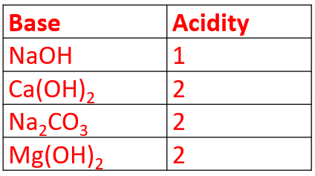
Some Basic Concepts of
Chemistry
(ii). Equivalent mass of base
Acidity is the number of OH⁻ ions produced in solution or total valency of the metal ion.
(iii) Equivalent mass of salt
Ex: KMnO₄ Equation Weight (In acid mediu
= 31.6g eq. +7 +2

Slide 60
Some Basic Concepts of
Chemistry
Relation b/w M and N
Normality x equivalent mass = molarity x molecular mass
Normality of 1M HCl
Normality of 1M H₂SO₄
Molefraction X:
It is the ratio of number of moles at a component to total number of moles of the components. Mole fraction of solvent,
mole fraction of solute, For a binary solution X_{A} + X_{B} = 1.
It is independent on temperature.
chemistry

Slide 61
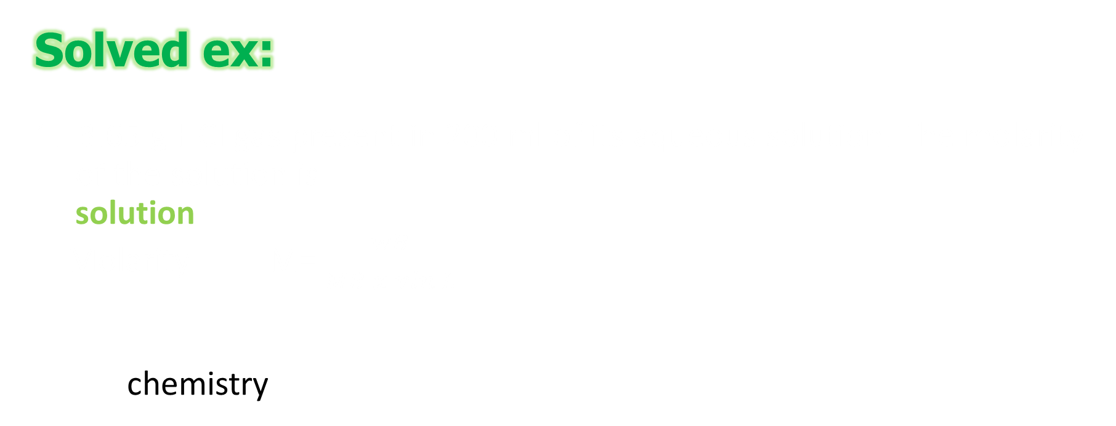
Some Basic Concepts of
Chemistry
Solved ex:
1. 3.65 g HCI gas present in 200 ml of its aqueous solution. The molarity
of the solution is
solution
Molarity M= $\frac{wB}{MB x vin L}$
chemistry

Slide 62

Some Basic Concepts of
Chemistry
2. 8 g NaOH dissolved in 500 mL of its aqueous solution. It
density of the solution is 1.2 g/mL then molality of the solution
will be
solution
d= $\frac{m}{V}$
m=d x V = 1.2 x 500 = 600g.
Weight of solvent, W_{A} = 600 – 8 = 592g
molality, m =

Slide 63
Some Basic Concepts of
Chemistry
How many ml of 1M H₂ SO₄ is required to neutralise 10.ml of
1M NaOH solution
Solution
2NaOH + H₂ SO₄ Na₂ SO₄ + 2H₂ O
M₁ V₁ M₂ V₂
V₂ = 5 mL
chemistry

Slide 64
Some Basic Concepts of
Chemistry
The malefaction of benzene in a solution containing 30% by
mass of it in CCl₄ is
solution
mass of benzene = 30 g
mass of CCl₄ = 70g
chemistry

Slide 65
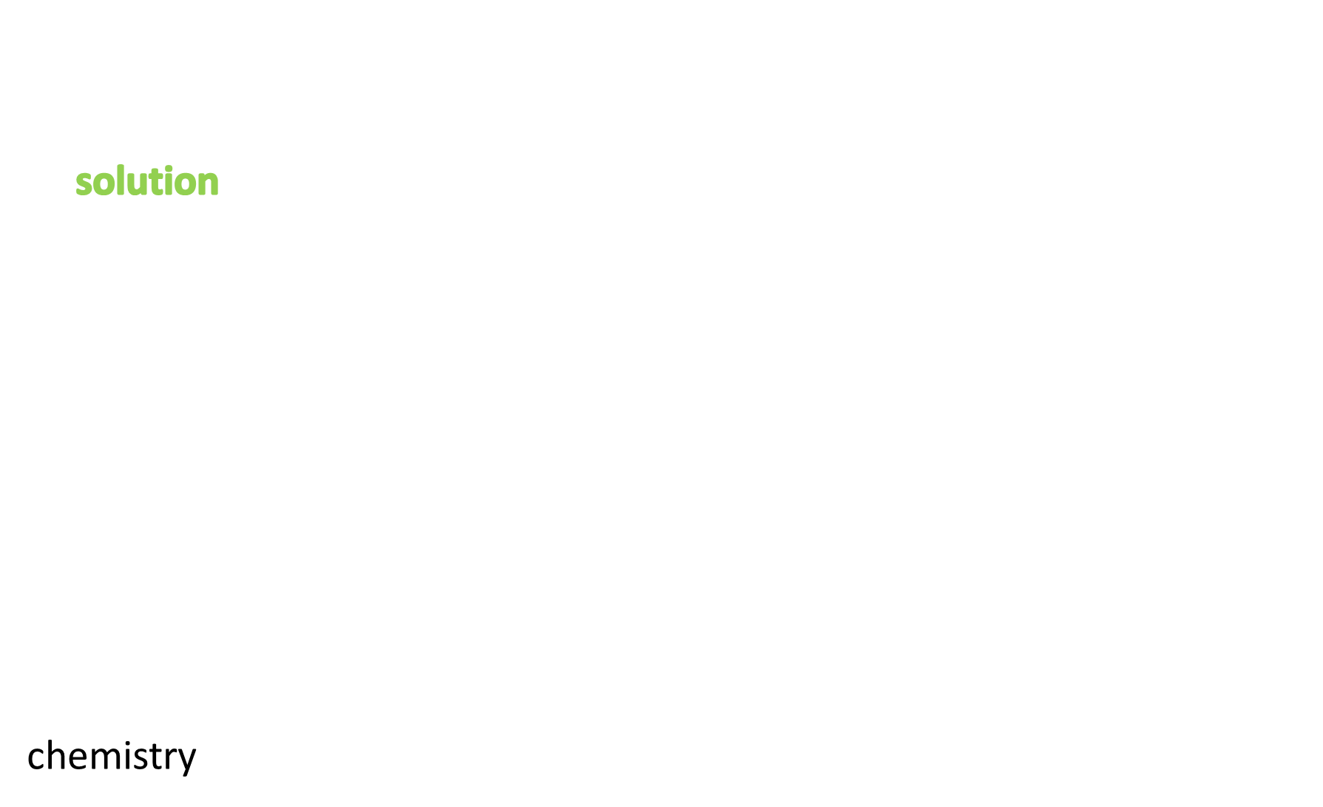
Some Basic Concepts of
Chemistry
1M aqueous solution of NaOH is neutralized by 200 ml of
2M HCI solution. The mas of NaCL produced is
solution
NaOH + HCl NaCl + H₂ O
40 g 36.5 g 58.5 g
mass of HCL in 200 mL of 2M solution,
2 = $\frac{w}{36.5 X 0.2}$
w = 14.6 g
Amount of NaCl produced by
14. 6 g of HCl
=
= 23.4 g
chemistry

Slide 66
Some Basic Concepts of
Chemistry
Thank you

